Slide 1
Powershell Automation Konten verstehen und anwenden
Christoph Wilfing
www.atwork.at
@cwilfing
Notes:
Introduction

Slide 2
Agenda
Was sind Automation Accounts?
Funktionsweise, Module,...
Wofür kann ich sie verwenden?
Powershell, Bash, Python,...
Integration?
DEMO DEMO DEMO!

Slide 3
Was ist ein Automation Account?
Task Scheduler für die Cloud

Slide 4
Moving parts
Authentication and security
Assets
Runbooks
Hybrid Runbook worker
Desired State Configuration

Slide 5
Authentication and Security
Automation Credential
Get-AutomationPSCredential [PSCredential]
Automation RunAs Account
Get-AutomationConnection [Certificate]
Classic Run As Account
Get-AutomationCertificate

Slide 6
Assets
Schedules
Modules
Credentials
Connections
Certificates
Variables

Slide 7
Runbooks
Graphical
Graphical Powershell Workflow
Powershell
Powershell Workflow
Python
Bash

Slide 8
Working with Runbooks
Azure Portal
Powershell
Webhooks
Respond to Azure Alert
Schedule
From Another Runbook (basically – powershell, webhook,..)
Variables

Slide 9
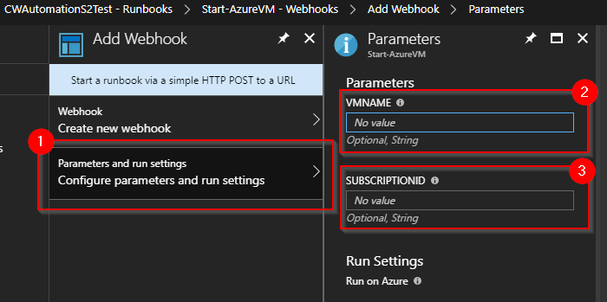
Runbook WebHooks - Part I

Slide 10
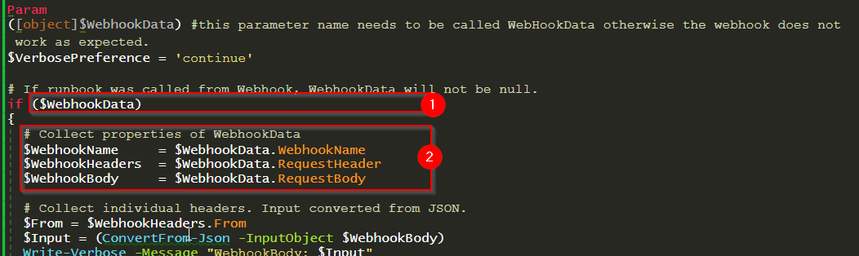
Runbook WebHooks - Part II

Slide 11
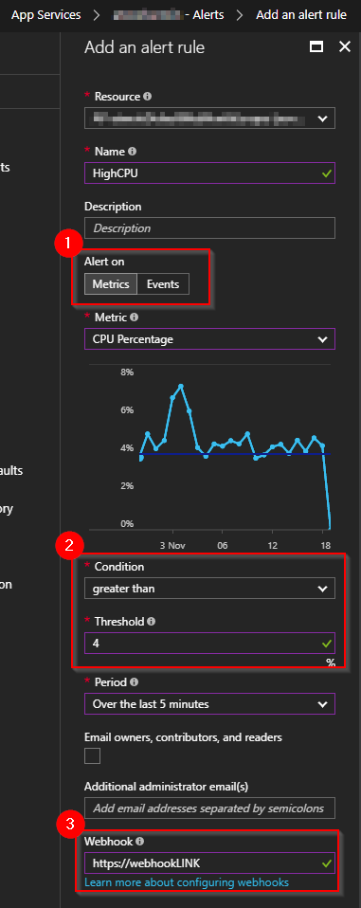
Azure Alerts - WebHook
App Services
Azure VMs
SQL Databases / SQL Server
…
Notes:
https://docs.microsoft.com/en-us/azure/monitoring-and-diagnostics/insights-webhooks-alerts

Slide 12
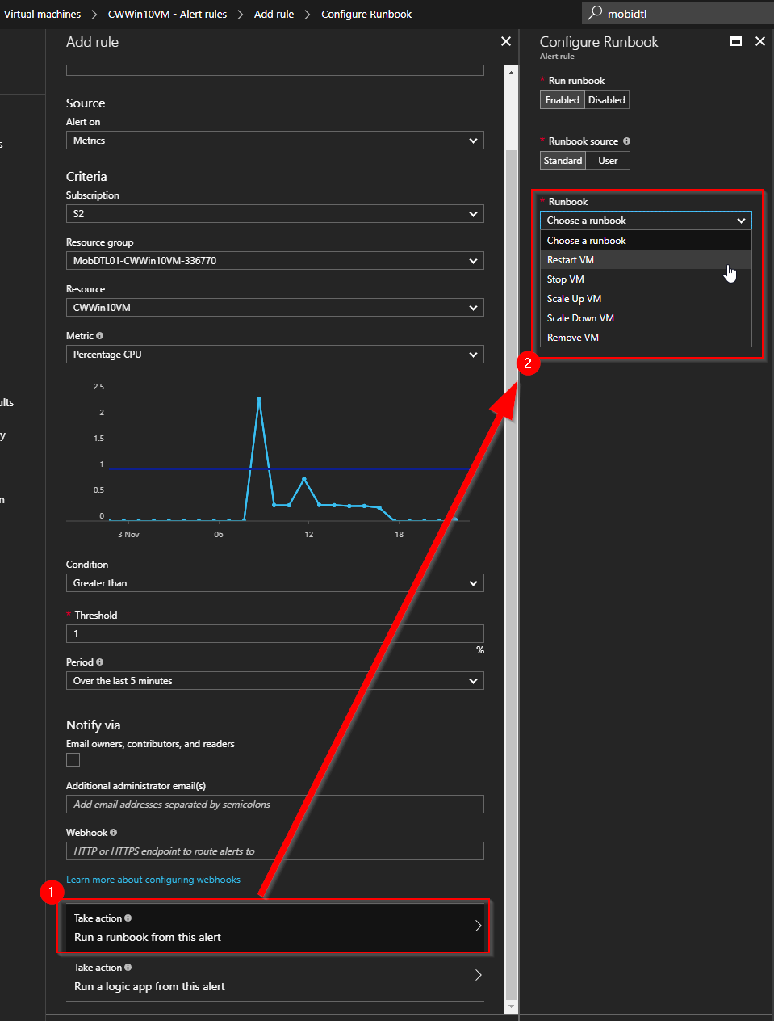
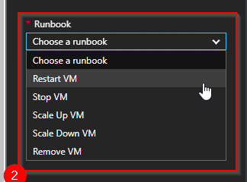
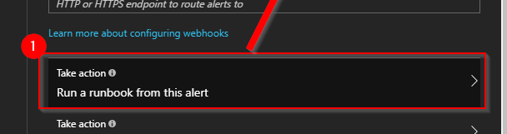
VM Alerts

Slide 13
DEMO
Runbooks and Webhooks

Slide 14
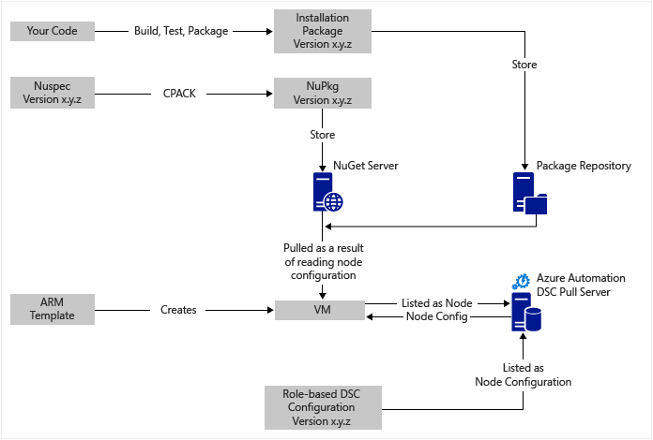
Continues delivery – with DSC

Slide 15
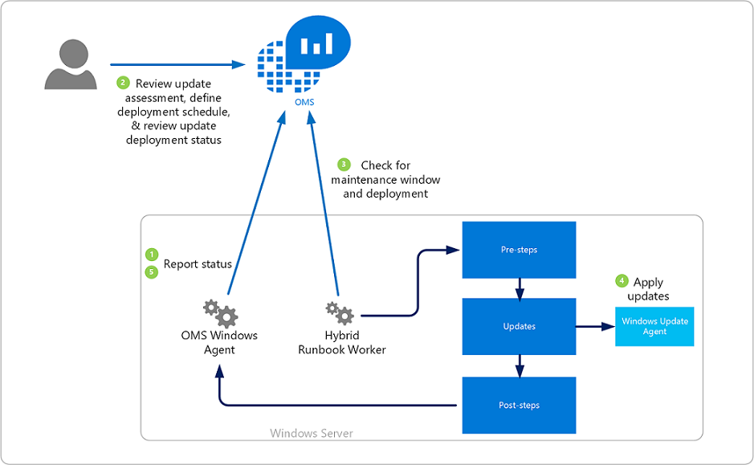
Update Management (preview)

Slide 16
Change Tracking (preview)
OMS Plugin
Azure Log Analytics
Hybrid Runbook Worker
Notes:
https://azure.microsoft.com/en-us/pricing/details/automation/

Slide 17
Inventory (Preview)
OMS Plugin
Azure Log Analytics
Hybrid Runbook Worker

Slide 18
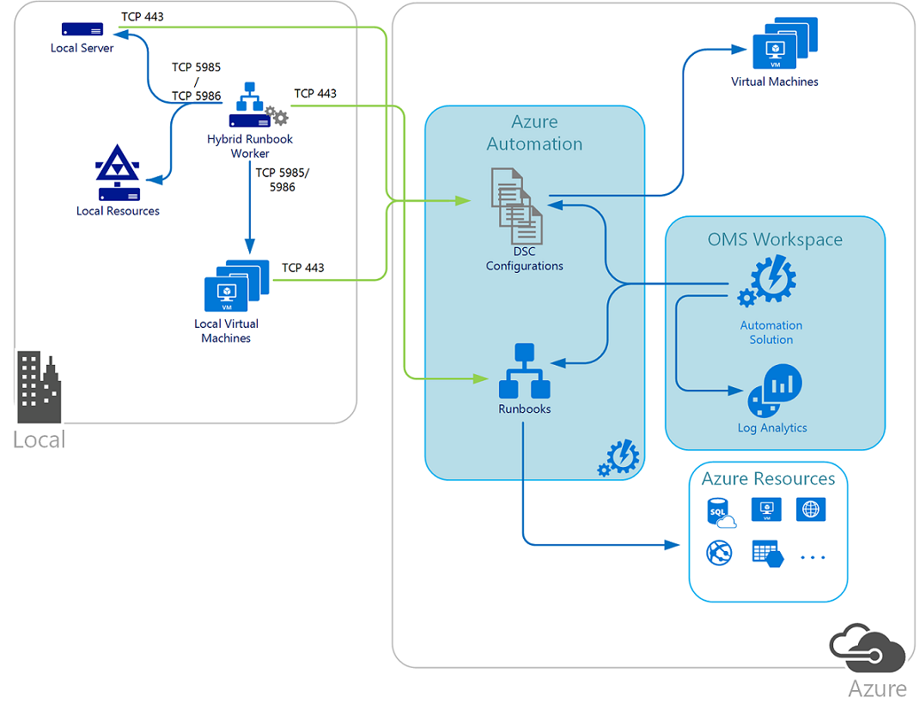
Solutions
Notes:
Source of Picture: https://docs.microsoft.com/en-us/azure/automation/automation-offering-get-started

Slide 19
OMS Gateway
Disconnected Environments
Systems without direct Internet Connection
Many Systems behind one connection

Slide 20
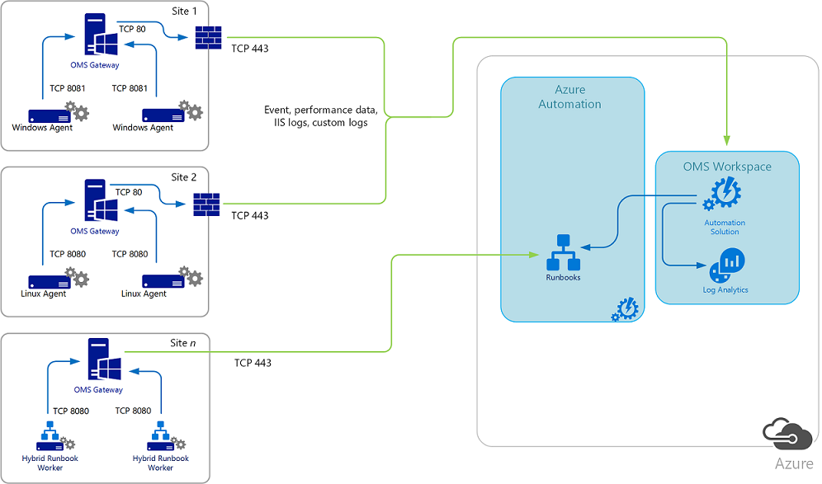
OMS Gateway
Notes:
Picture source: https://docs.microsoft.com/en-us/azure/log-analytics/log-analytics-oms-gateway

Slide 21
Integration
Logic App
Trigger - Twitter Tweet
Action – HTTP Webhook (Automation Runbook)

Slide 22
DEMO
Logic Apps und Automation Accounts

Slide 23
Pricing
Automation
500 Minutes Free | € 0.002/Minute runtime
Config management
First 5 Nodes Free | After that €5.0598/node
Azure Nodes are FREE
Notes:
https://azure.microsoft.com/en-us/pricing/details/automation/
Config Management Includes Pull Service + Change Management

Slide 24
Pricing continued
Update management – FREE
Only Azure Log Analytics are charged
Free Tier - 500MB/Day, Retention 7 Days
Basic Tier – € 1.94/GB, 1 Month Retention
Notes:
Charges for Log Analytics
https://azure.microsoft.com/en-us/pricing/details/log-analytics/

Slide 25
Linksammlung
Microsoft Docs - Automation Get Started
https://docs.microsoft.com/en-us/azure/automation/automation-offering-get-started
Azure Automation Authoring ISE Addon
https://github.com/azureautomation/azure-automation-ise-addon

Slide 26
Linksammlung - Continued

Slide 27















Thanks to our Sponsors!

